Slide 1
Remedial Education Commission
1 September 2011

Slide 2
Developmental Education
In the U.S.
In Louisiana
+6
+4.7
+4
+2.1
Notes:
30,000 foot overview, in line with this initial meeting of the commission which is designed to be a sort of orientation to developmental education (also called remedial education).
There is a Feedback Form in the first section of your binder. If you want to know more about any of these (or other) topics, please let us know and we’ll do our best to get what you need.

Slide 3
Developmental Course Enrollments First-year Undergraduates, 2007-08
U.S. | 1 Course | ≥ 2 Courses
4-Yr Doctorate | 10% | 7%
4-Yr Nondoctorate | 12% | 13%
2-Yr | 11% | 13%
LA | 1 Course | ≥ 2 Courses
Flagship & Statewide | 9% | 0%
Regional | 25% | 5%
2-Yr | 29% | 38%

Slide 4
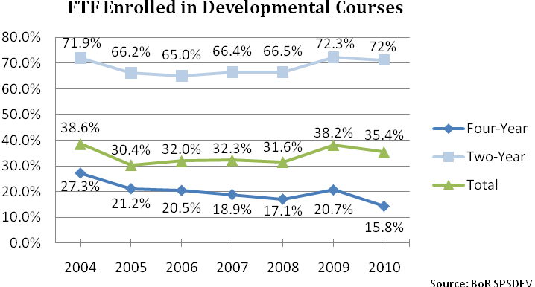
Notes:
- GRAD Act measure:

Slide 5
Curriculum Matters
Notes:
Curriculum really does matter.

Slide 6
ACT Mathematics Scores By Preparation Level
ACT Readiness
Benchmark
Board of Regents
Minimum Score
22
+6
+4.7
+4
+2.1
ACT Louisiana Class of 2010

Slide 7
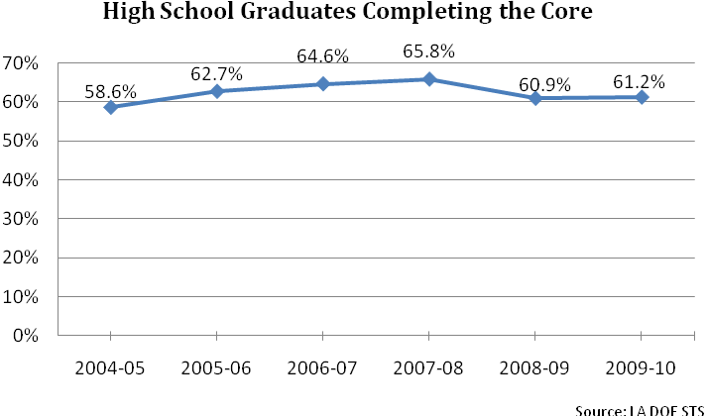
In 2008, core changed to require an additional math or science.
+6
+4.7
+4
+2.1
LDE Projections for 2012 > 80%

Slide 8
Minimum Admission Standards

Slide 9
Board of Regents
At its February 2008 meeting
“…voted unanimously to accept the recommendation of the Planning, Research, and Performance Committee to adopt the Louisiana Core 4 academic core as the Regents’ Core for entry into 4-year institutions, to become effective with the high school graduating class of 2012.”
Notes:
Until 2005, many universities in Louisiana remained open-admission. The 2001 Master Plan established the state’s first minimum admission criteria, based on a Core, and GPA or ACT. The first Regents’ Core = TOPS Core.
The standards were tweaked a little over the next couple of years, and Regents staff worked with The Department and the HS Redesign Commission to develop the Core 4 curriculum to better prepare students for life after high school -- college or career.
To support HS Redesign and in an attempt to make it easier for students to keep track of the various cores, the BoR adopted the LA Core 4 as the Regents’ Core in 2008 – effective Fall, 2012.

Slide 10
Regents HS Core (LA Core 4)** for Admission* to Universities, Fall 2012
4 ENGLISH | - English I, II, III, and IV
4 MATH | - Algebra I/Applied Algebra I/Algebra I-Pt. 2 - Geometry/Applied Geometry - Algebra II - Financial Math/Math Essentials/Advanced: Pre-Calculus/Advanced: Functions & Statistics/Pre-Calculus/Calculus/Probability and Statistics/Discrete Math/apprvd elec.
4 SCIENCE | - Biology - Chemistry - 2 units from: Physical Science/Integrated Science/Physics I/Physics of Technology I/ Aerospace Science/Biology II/Chemistry II/Earth Science/Environmental Science/ Physics II/Physics of Technology II/Agriscience II/Anatomy and Physiology/approved elective(including approved IBC-related course)
4 SOCIAL STUDIES | - Civics/AP American Government + Free Enterprise (½ unit each) - American History - World History/World Geography/Western Civilization/AP European History - World History/World Geography/Western Civilization/AP European History/ Law Studies/Psychology/Sociology/Civics (2nd sem, ½ unit)/African American Studies/approved IBC-related course/(Religion I,II,III,IV for nonpublic schools)
2 LANGUAGE | - 2 units from same language or 2 Speech courses
1 ARTS | - Fine Arts Survey or 1 unit: Art/Dance/Music/Theatre Arts/Applied Arts/approved IBC-related course
19 UNITS
Notes:
In your binders, you have a full-page handout of the Core 4 – which you can see includes 4 Engl, 4 Math, 4 Sci, and 4 Social Studies. The Regents’ Core remains linked to The Department via the Bulletins 741, which will reflect additional course detail as the Core 4 evolves. The hope and expectation is that this more rigorous core, along with the Department’s work on Common Core Standards and End-of-Course exams will lead to more qualified graduates, starting with 2012, thus lessening the need for developmental education -- -- that students will be better prepared for career and college.

Slide 11
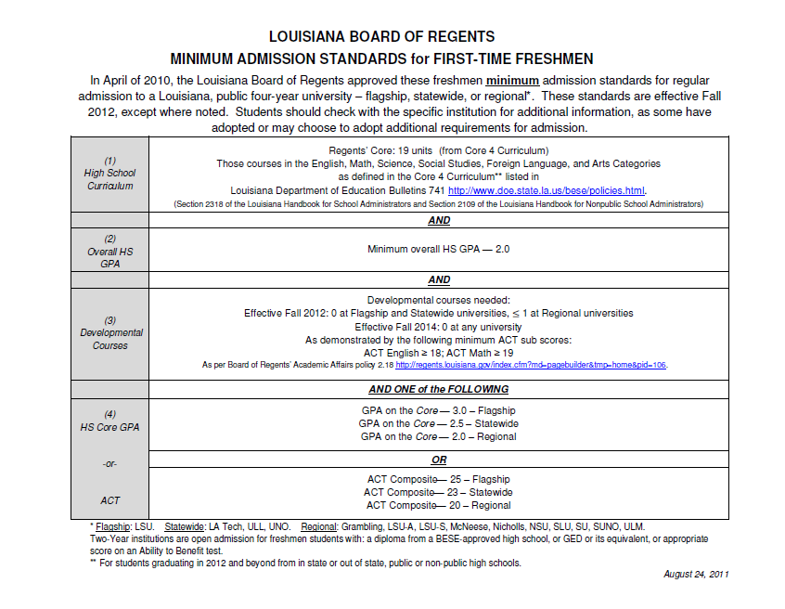
Notes:
You also have a full-page handout of this in your binder. For 2012, the minimum admission standards are a little tighter than the 2005 original, in that it requires the new Regents’/Core 4 Core, and the GPA calculation is now on the core rather than an overall GPA. But the main difference is in the developmental component, which moves developmental coursework to the 2-year and community colleges.
This move of developmental coursework to the 2-year schools is reflected in several places, beginning with LCTCS assuming responsibility for ABE and Developmental from The Department of Education.
It’s also in line with the GRAD Act (Act 741, in 2010), which called for universities to “Eliminate remedial education course offerings and developmental study programs unless such courses or programs cannot be offered at a community college in the same geographic area.”
Developmental courses were eliminated from LSU with the admission standards of 2005, and will move from the statewide campuses in 2012 and from regionals in 2014.

Slide 12
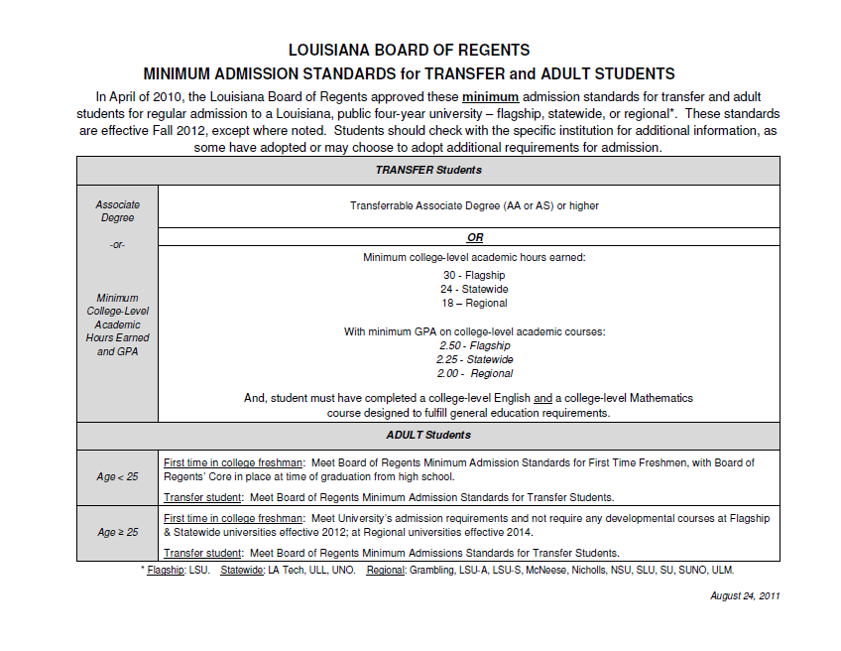
Notes:
The same is true for the transfer admission standards: students must complete a number of college-level courses, including at least one English and math course before transferring. This is especially pertinent for students who start in developmental courses – the standard requires that they also complete the matching college-level courses before moving.

Slide 13
A Look at the Data

Slide 14
Enrollment in Remedial Courses
+6
+4.7
+4
+2.1
Remedial Course Enrollment, Fall 2006: First-Time Entry Students
Math = 6,798
English = 3,990

Slide 15
Enrollment & Progression in Remedial Education
 | A | B | C | D
Institution | TOTAL First-Time Entry Students, Fall 2006 | Enrolled in Remedial Course | Completed Remedial Course | Completed College-Lvl Course, Same Subj, w/in 2 years of Entry
2-Yr | 6,454 | 4,073 | 1,932 | 563
4-Yr | 21,555 | 4,305 | 2,851 | 1,453
TOTAL | 28,009 | 8,378 | 4,783 | 2,016
 |  | (B/A) | (C/B) | (D/C) | (D/B)
2-Yr |  | 63.1% | 47.4% | 29.1% | 13.8%
4-Yr |  | 20.0% | 66.2% | 51.0% | 33.8%
TOTAL |  | 29.9% | 57.1% | 42.1% | 24.1%
+6
+4.7
+4
+2.1

Slide 16
Remedial Math, Only
 | A | B | C | D
Institution | TOTAL First-Time Entry Students, Fall 2006 | Enrolled in Remedial Course | Completed Remedial Course | Completed College-Lvl Course, Same Subj, w/in 2 years of Entry
2-Yr | 6,454 | 1,959 | 1,169 | 344
4-Yr | 21,555 | 2,429 | 1,629 | 843
TOTAL | 28,009 | 4,388 | 2,798 | 1,187
 |  | (B/A) | (C/B) | (D/C) | (D/B)
2-Yr |  | 30.4% | 59.7% | 29.4% | 17.6%
4-Yr |  | 11.3% | 67.1% | 51.7% | 34.7%
TOTAL |  | 15.7% | 63.8% | 42.4% | 27.1%
+6
+4.7
+4
+2.1

Slide 17
Remedial English, Only
 | A | B | C | D
Institution | TOTAL First-Time Entry Students, Fall 2006 | Enrolled in Remedial Course | Completed Remedial Course | Completed College-Lvl Course, Same Subj, w/in 2 years of Entry
2-Yr | 6,454 | 417 | 183 | 101
4-Yr | 21,555 | 1,163 | 907 | 482
TOTAL | 28,009 | 1,580 | 1,090 | 583
 |  | (B/A) | (C/B) | (D/C) | (D/B)
2-Yr |  | 6.5% | 43.9% | 55.2% | 24.2%
4-Yr |  | 5.4% | 78.0% | 53.1% | 41.4
TOTAL |  | 5.6% | 69.0% | 53.5% | 36.9%
+6
+4.7
+4
+2.1

Slide 18
Both Math and English (Remedial)
 | A | B | C | D
Institution | TOTAL First-Time Entry Students, Fall 2006 | Enrolled in Remedial Course | Completed Remedial Course | Completed College-Lvl Course, Same Subj, w/in 2 years of Entry
2-Yr | 6,454 | 1,697 | 580 | 118
4-Yr | 21,555 | 713 | 315 | 128
TOTAL | 28,009 | 2,410 | 895 | 246
 |  | (B/A) | (C/B) | (D/C) | (D/B)
2-Yr |  | 26.3% | 34.2% | 20.3% | 7.0%
4-Yr |  | 3.3% | 44.2% | 40.6% | 18.0%
TOTAL |  | 8.6% | 37.1% | 27.5% | 10.2%
+6
+4.7
+4
+2.1

Slide 19
GRADUATION RATES: Associate Degree (Beginning Cohort: Fall 2004)
Full-Time Students | Beginning Cohort | Graduated within 3 Yrs | % Graduating within 3 Yrs
Total Students | 6,030 | 253 | 4.2%
Remedial* | 3,992 | 109 | 2.7%
66% of entering full-time students seeking an associate degree took a developmental course at the time of entry.
+6
+4.7
+4
+2.1
Notes:
- Of the 6,030 students seeking an Associate degree who entered in 2003, 66% (66.2) took a developmental course in their first semester.

Slide 20
GRADUATION RATES: Bachelor’s Degree (Beginning Cohort: Fall 2003)
Full-Time Students | Beginning Cohort | Graduated Within 6 Yrs | % Graduating Within 6 Yrs
Total Students | 23,175 | 10,117 | 43.7%
Remedial* | 5,491 | 1,223 | 22.3%
24% of entering full-time students seeking a bachelor’s degree took a developmental course at the time of entry.
+6
+4.7
+4
+2.1
Notes:
- Of the 23,175 students seeking a Bachelor’s degree who entered in 2003, 24% (23.7) took a developmental course in their first semester.

Slide 21
Estimated Cost
Developmental SCHs = .0444 of TOTAL SCHs
Total 2011-12 Operating Budget = $1,734,326,830
Estimated Cost of DevEd = $76,558,720
Equivalent to Total State Generated Funds Allocated for:
LSUHSC-NO, or
NSU + SLU, or
LSUA + LSUE + LSUS + UNO + SUSLA

